Slide 1
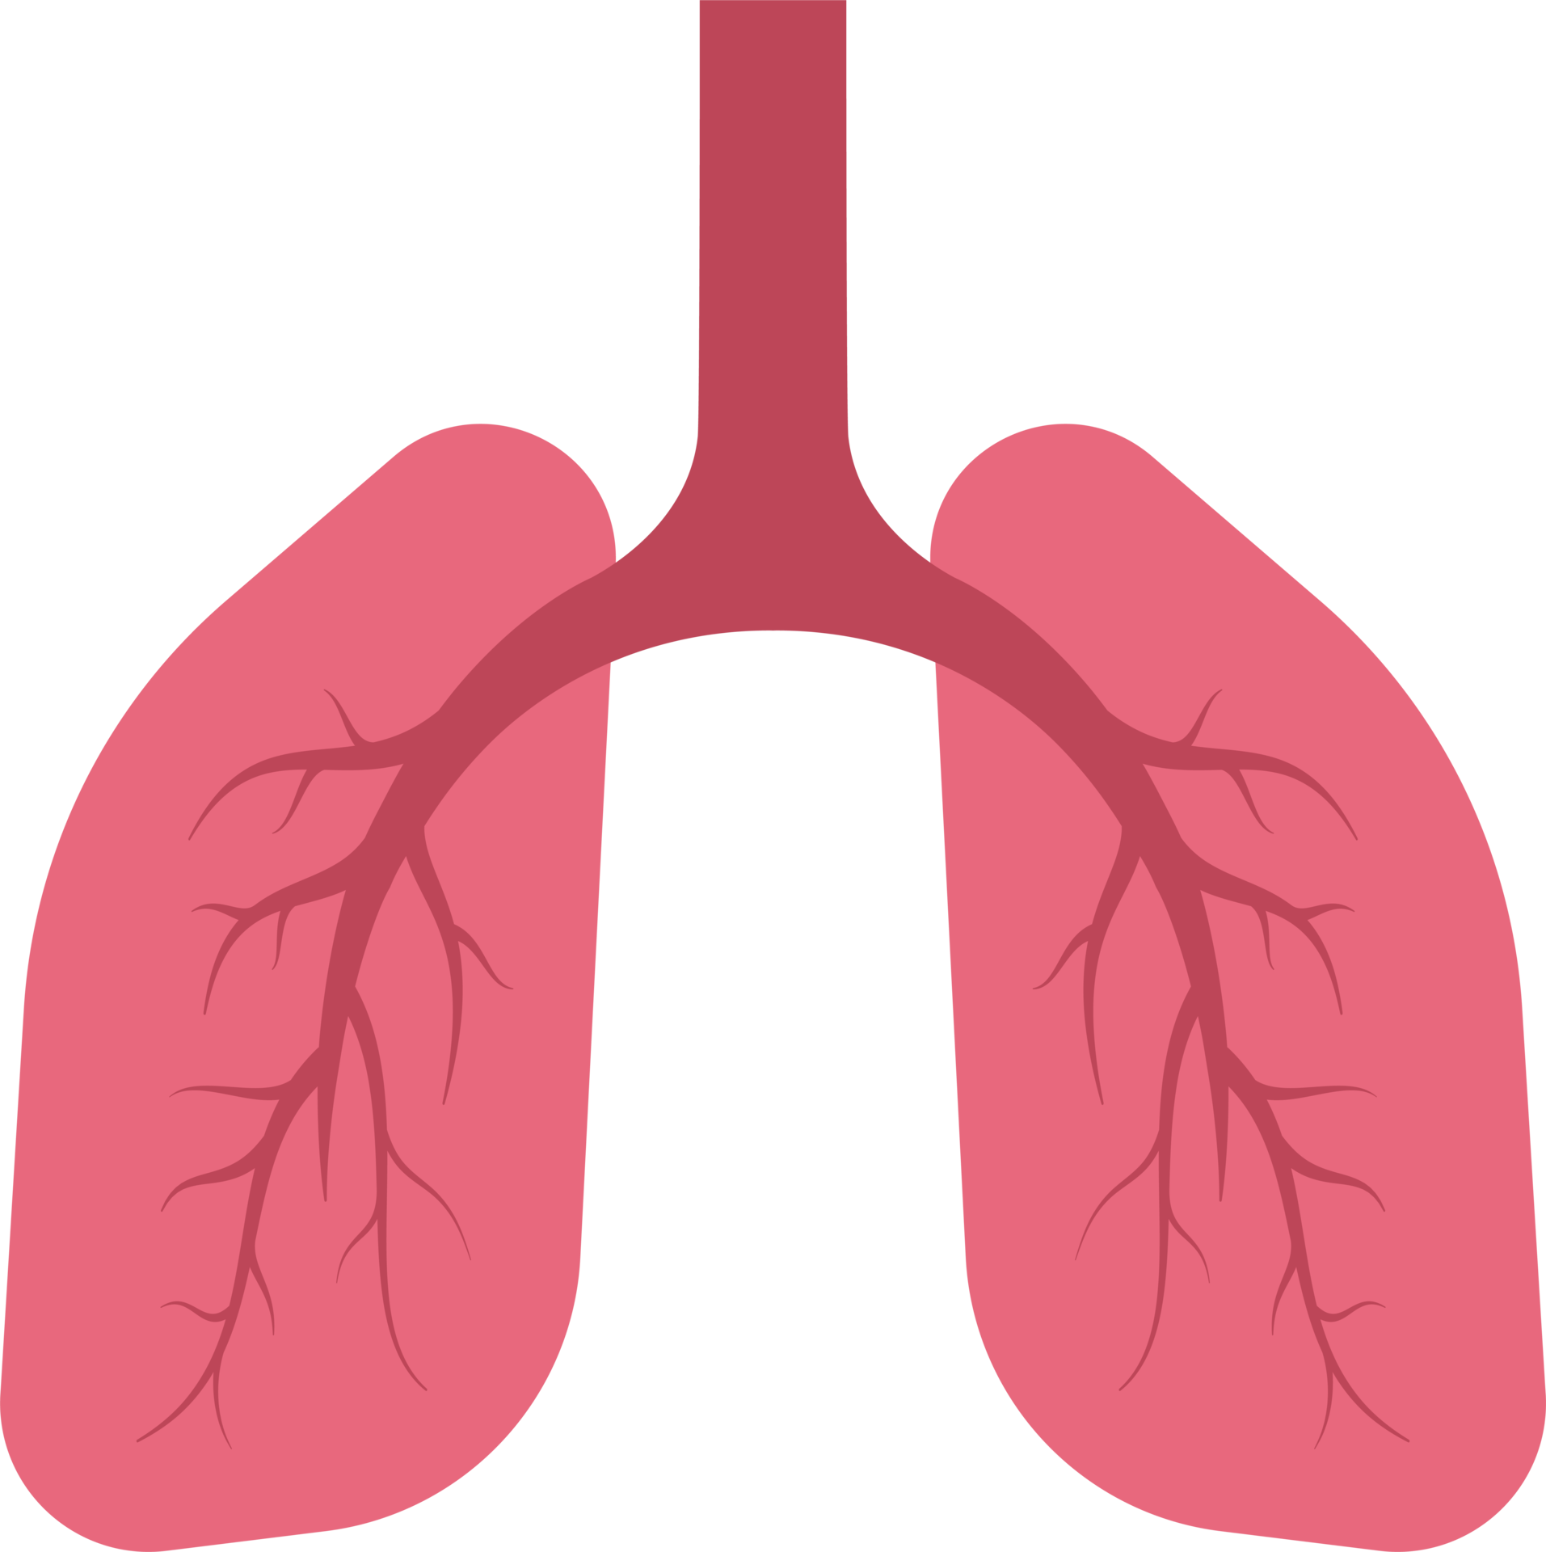
Classification Step
Lung Cancer?
Yes
No
Small or Non-Small?
Normal
Non-small
Small

Slide 2
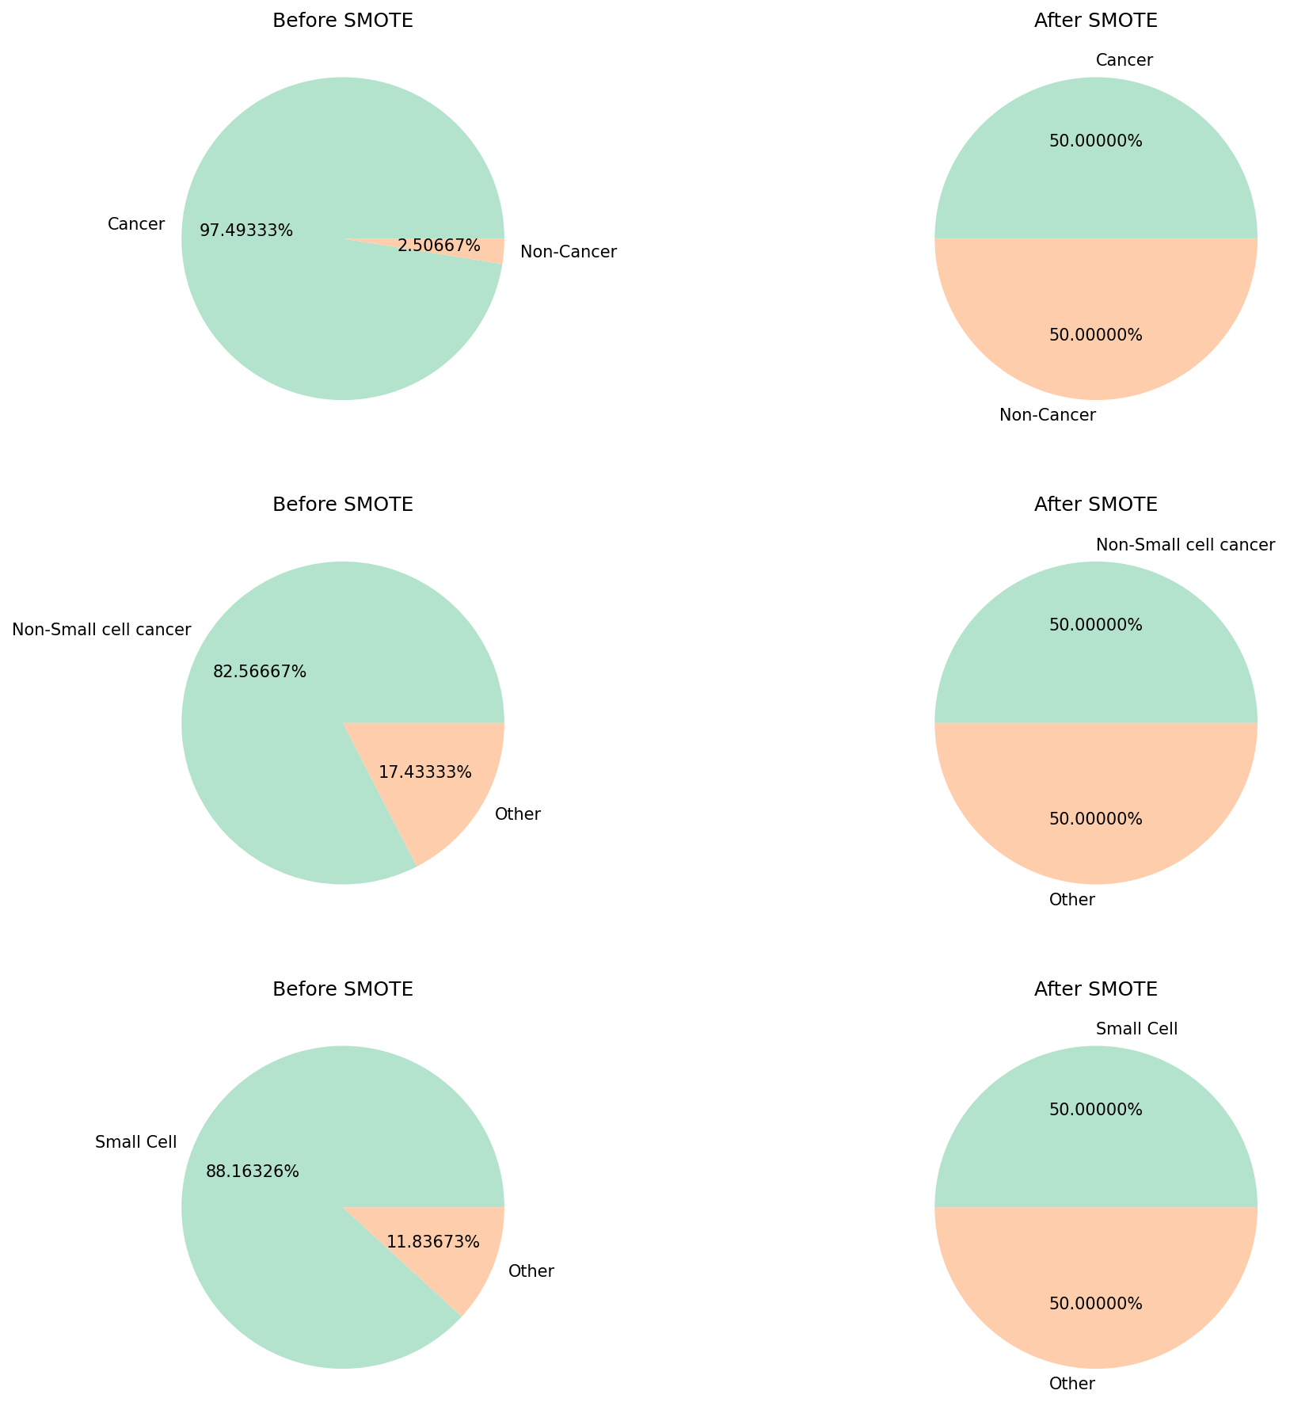
Preprocessing; SMOTE

Slide 3

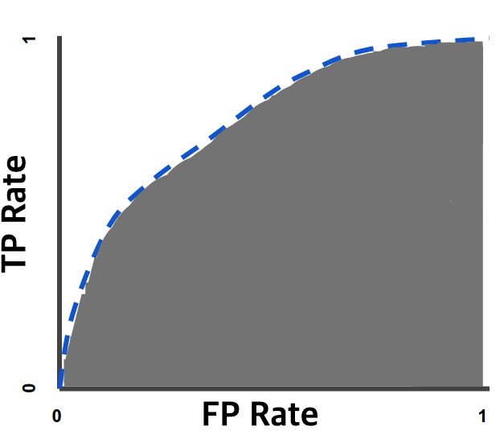



Evaluation; 5-fold Cross validation
Metrics; Accuracy, AUC, F1-Score

Slide 4
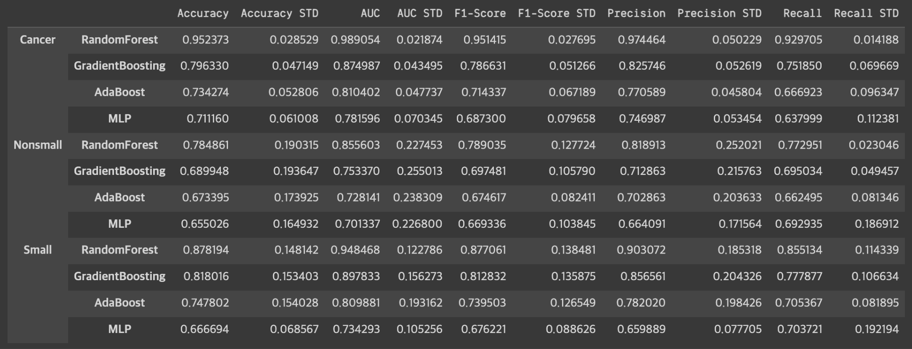
Classifying; Cancer or not
Random Forest
Accuracy : 0.95 +/- 0.02
AUC : 0.98 +/- 0.02
F1-Score : 0.95 +/- 0.03

Slide 5
Classifying; Non-small/Small or not
Non-Small
Random Forest
Accuracy : 0.78 +/- 0.2
AUC : 0.85 +/- 0.23
F1-Score : 0.79 +/- 0.13
Small
Random Forest
Accuracy : 0.88 +/- 0.15
AUC : 0.95 +/- 0.12
F1-Score : 0.88 +/- 0.14

